Slide 1
Envelope analysis
October 2024
Andrea Corrado

Slide 2
Outline
Aim of envelope analysis
Envelope analysis pipeline
Envelope derivative
Derivative thresholding and merging
False peak detection
Time thresholds definition
Results
Positive results
Misleading results
Proposed features
Conclusions

Slide 3
Outline
Aim of envelope analysis
Envelope analysis pipeline
Envelope derivative
Derivative thresholding and merging
False peak detection
Time thresholds definition
Results
Positive results
Misleading results
Proposed features
Conclusions

Slide 4
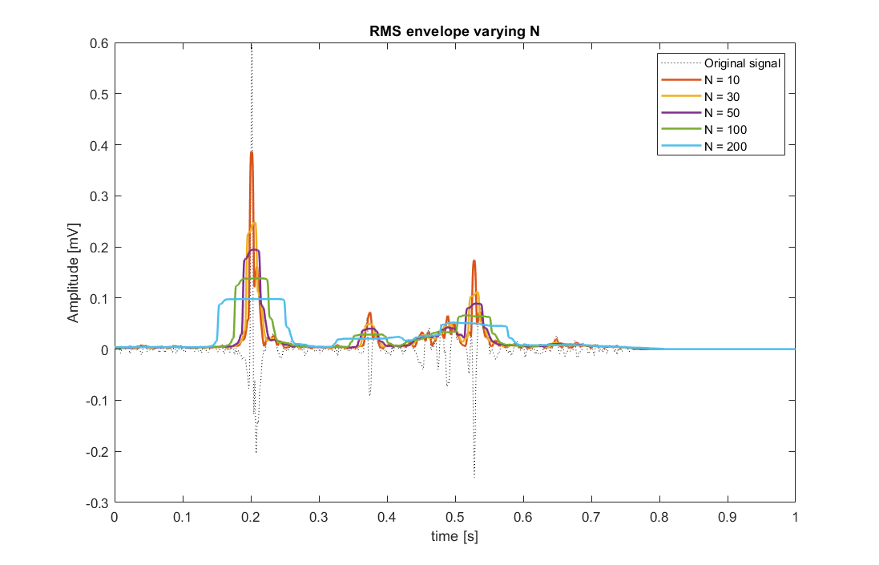
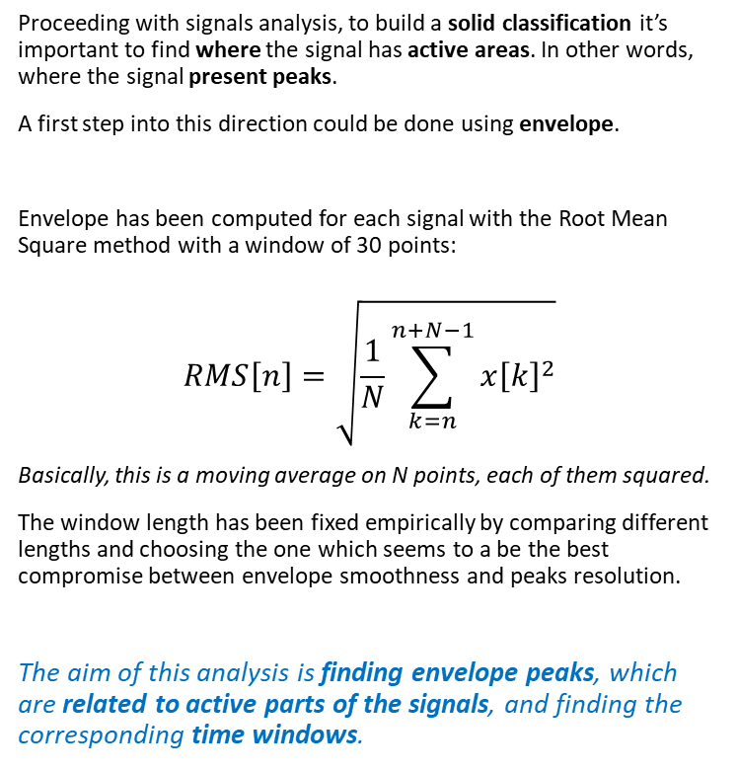
Aim of envelope analysis
Proceeding with signals analysis, to build a solid classification it’s important to find where the signal has active areas. In other words, where the signal present peaks.
A first step into this direction could be done using envelope.
Envelope has been computed for each signal with the Root Mean Square method with a window of 30 points:
$$RMS\left[n\right]=\sqrt{\frac{1}{N}\sum_{k=n}^{n+N−1}{x{\left[k\right]}^{2}}}$$
Basically, this is a moving average on N points, each of them squared.
The window length has been fixed empirically by comparing different lengths and choosing the one which seems to a be the best compromise between envelope smoothness and peaks resolution.
The aim of this analysis is finding envelope peaks, which are related to active parts of the signals, and finding the corresponding time windows.

Slide 5
Outline
Aim of envelope analysis
Envelope analysis pipeline
Envelope derivative
Derivative thresholding and merging
False peak detection
Time thresholds definition
Results
Positive results
Misleading results
Proposed features
Conclusions

Slide 6
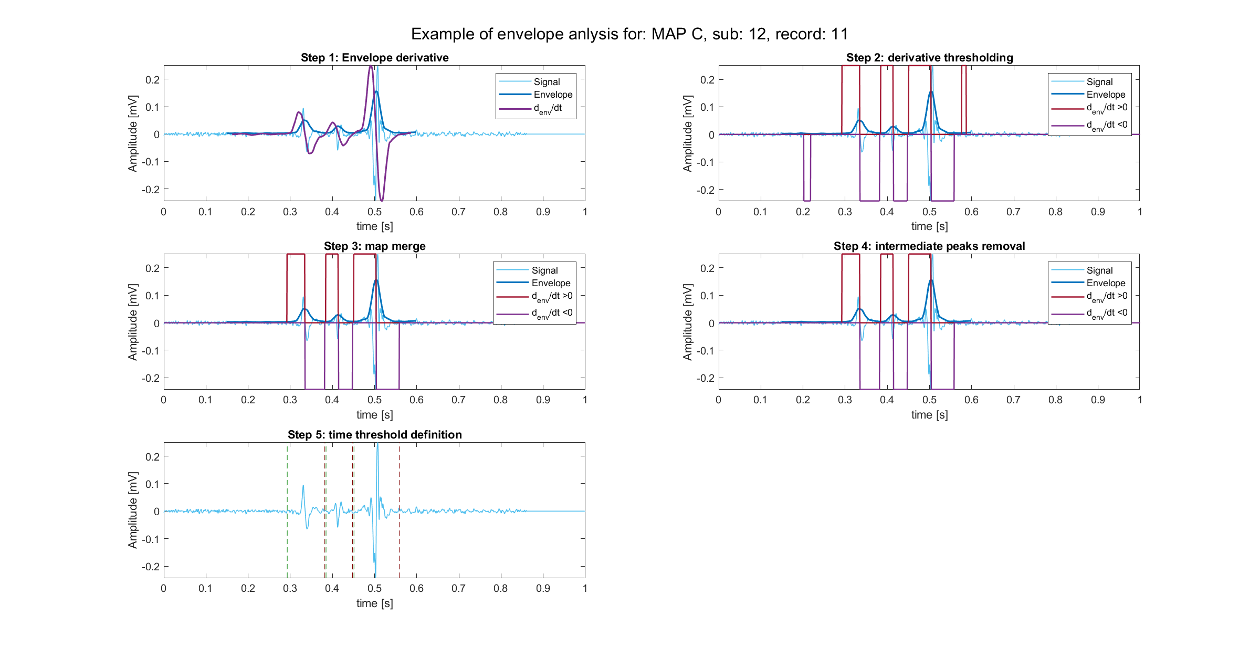
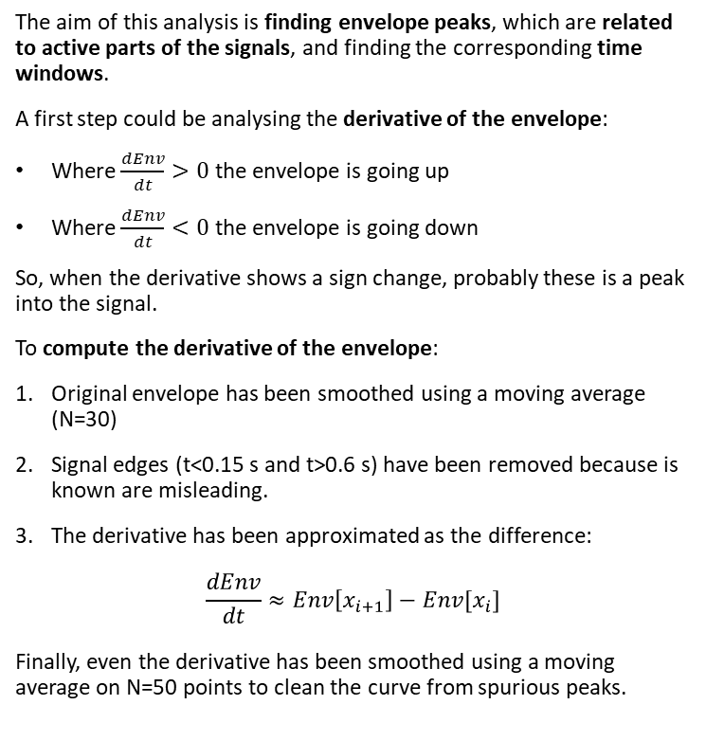
Envelope analysis: derivative computation
The aim of this analysis is finding envelope peaks, which are related to active parts of the signals, and finding the corresponding time windows.
A first step could be analysing the derivative of the envelope:
Where $\frac{dEnv}{dt}>0$ the envelope is going up
Where $\frac{dEnv}{dt}<0$ the envelope is going down
So, when the derivative shows a sign change, probably these is a peak into the signal.
To compute the derivative of the envelope:
Original envelope has been smoothed using a moving average (N=30)
Signal edges (t<0.15 s and t>0.6 s) have been removed because is known are misleading.
The derivative has been approximated as the difference:
$$\frac{dEnv}{dt}≈Env\left[x_{i+1}\right]−Env[x_{i}]$$
Finally, even the derivative has been smoothed using a moving average on N=50 points to clean the curve from spurious peaks.

Slide 7
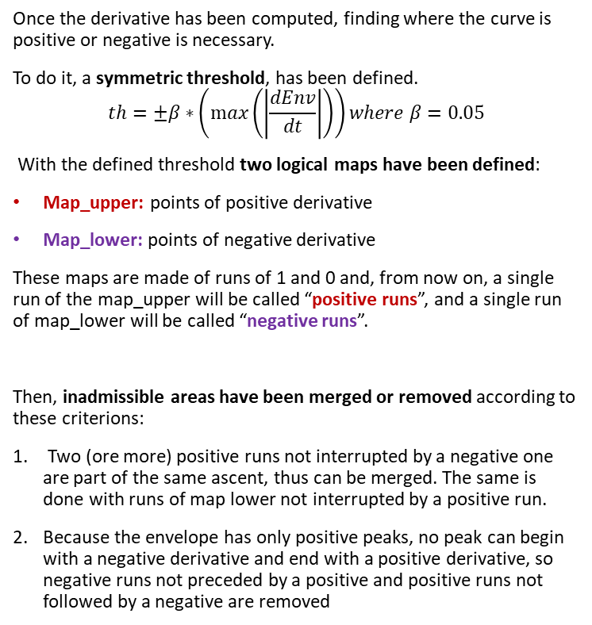
Envelope analysis: derivative thresholding
Once the derivative has been computed, finding where the curve is positive or negative is necessary.
To do it, a symmetric threshold, has been defined.
$$th=±β∗\left(\max\left(\left|\frac{dEnv}{dt}\right|\right)\right)where β=0.05$$
With the defined threshold two logical maps have been defined:
Map_upper: points of positive derivative
Map_lower: points of negative derivative
These maps are made of runs of 1 and 0 and, from now on, a single run of the map_upper will be called “positive runs”, and a single run of map_lower will be called “negative runs”.
Then, inadmissible areas have been merged or removed according to these criterions:
Two (ore more) positive runs not interrupted by a negative one are part of the same ascent, thus can be merged. The same is done with runs of map lower not interrupted by a positive run.
Because the envelope has only positive peaks, no peak can begin with a negative derivative and end with a positive derivative, so negative runs not preceded by a positive and positive runs not followed by a negative are removed

Slide 8
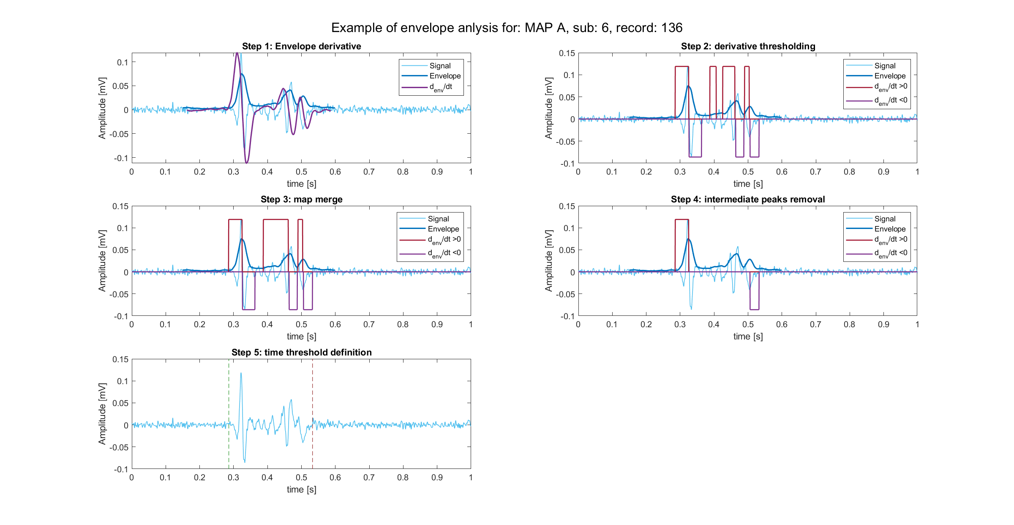
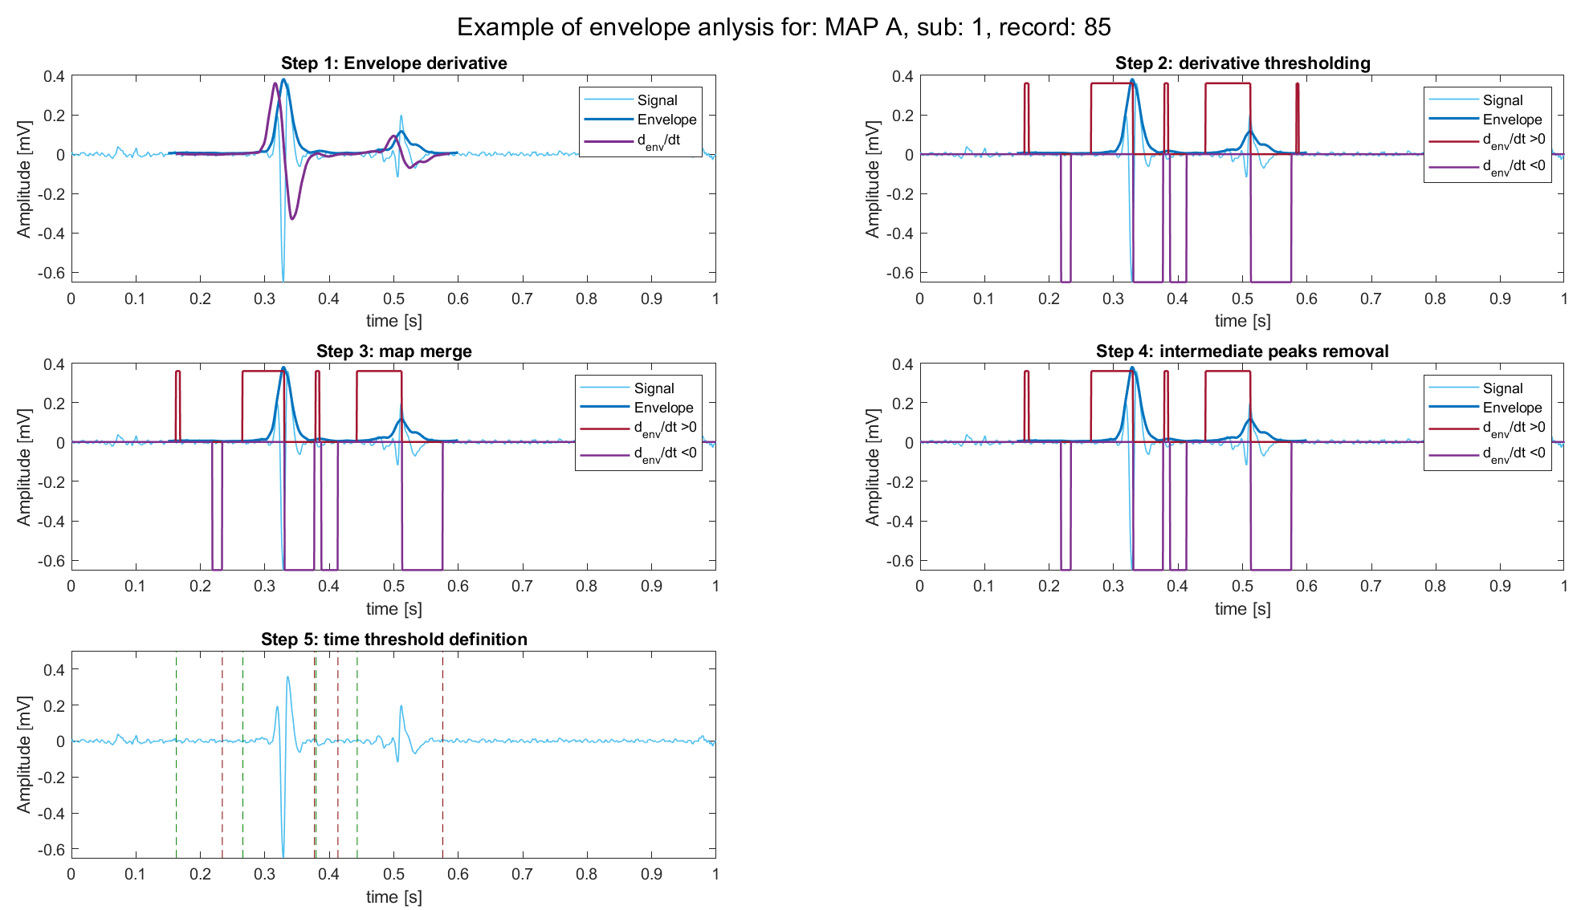
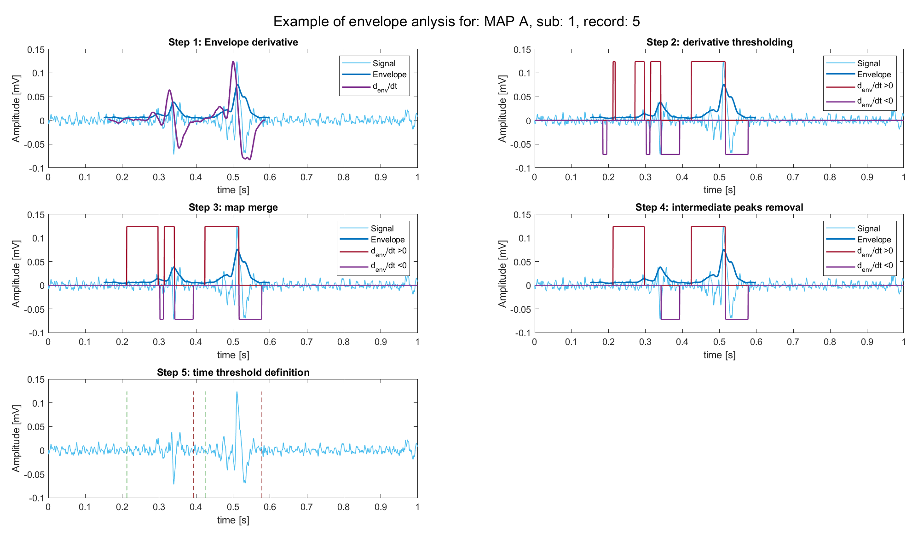
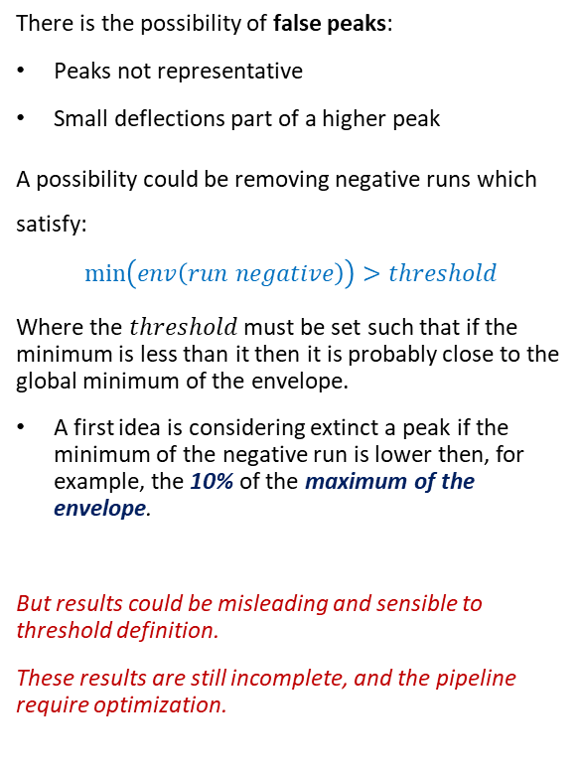
Envelope analysis: false peak detection
There is the possibility of false peaks:
Peaks not representative
Small deflections part of a higher peak
A possibility could be removing negative runs which satisfy:
$$\min\left(env\left(run negative\right)\right)>threshold$$
Where the $threshold$ must be set such that if the minimum is less than it then it is probably close to the global minimum of the envelope.
A first idea is considering extinct a peak if the minimum of the negative run is lower then, for example, the 10% of the maximum of the envelope.
But results could be misleading and sensible to threshold definition.
These results are still incomplete, and the pipeline require optimization.

Slide 9
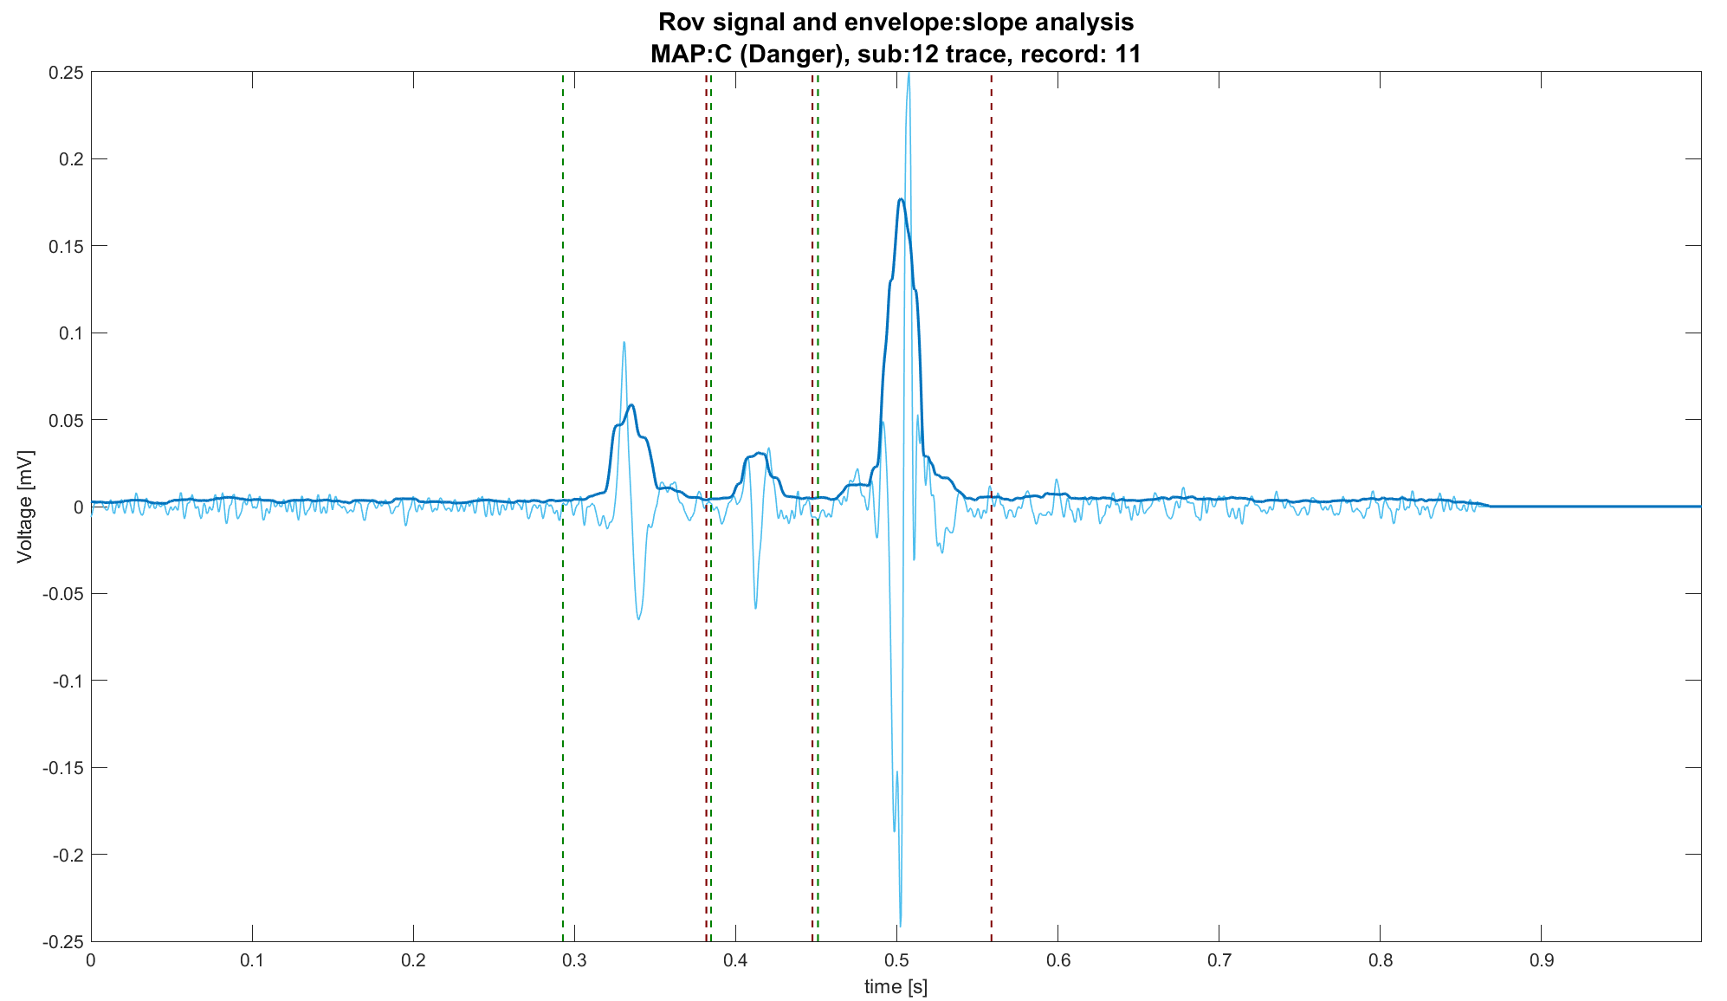
Envelope analysis: time threshold definition
Finally, time threshold can be computed easily:
First point of each positive run begins an active portion
Last point of each negative run ends the active portion

Slide 10
Outline
Aim of envelope analysis
Envelope analysis pipeline
Envelope derivative
Derivative thresholding and merging
False peak detection
Time thresholds definition
Results
Positive results
Misleading results
Proposed features
Conclusions

Slide 11
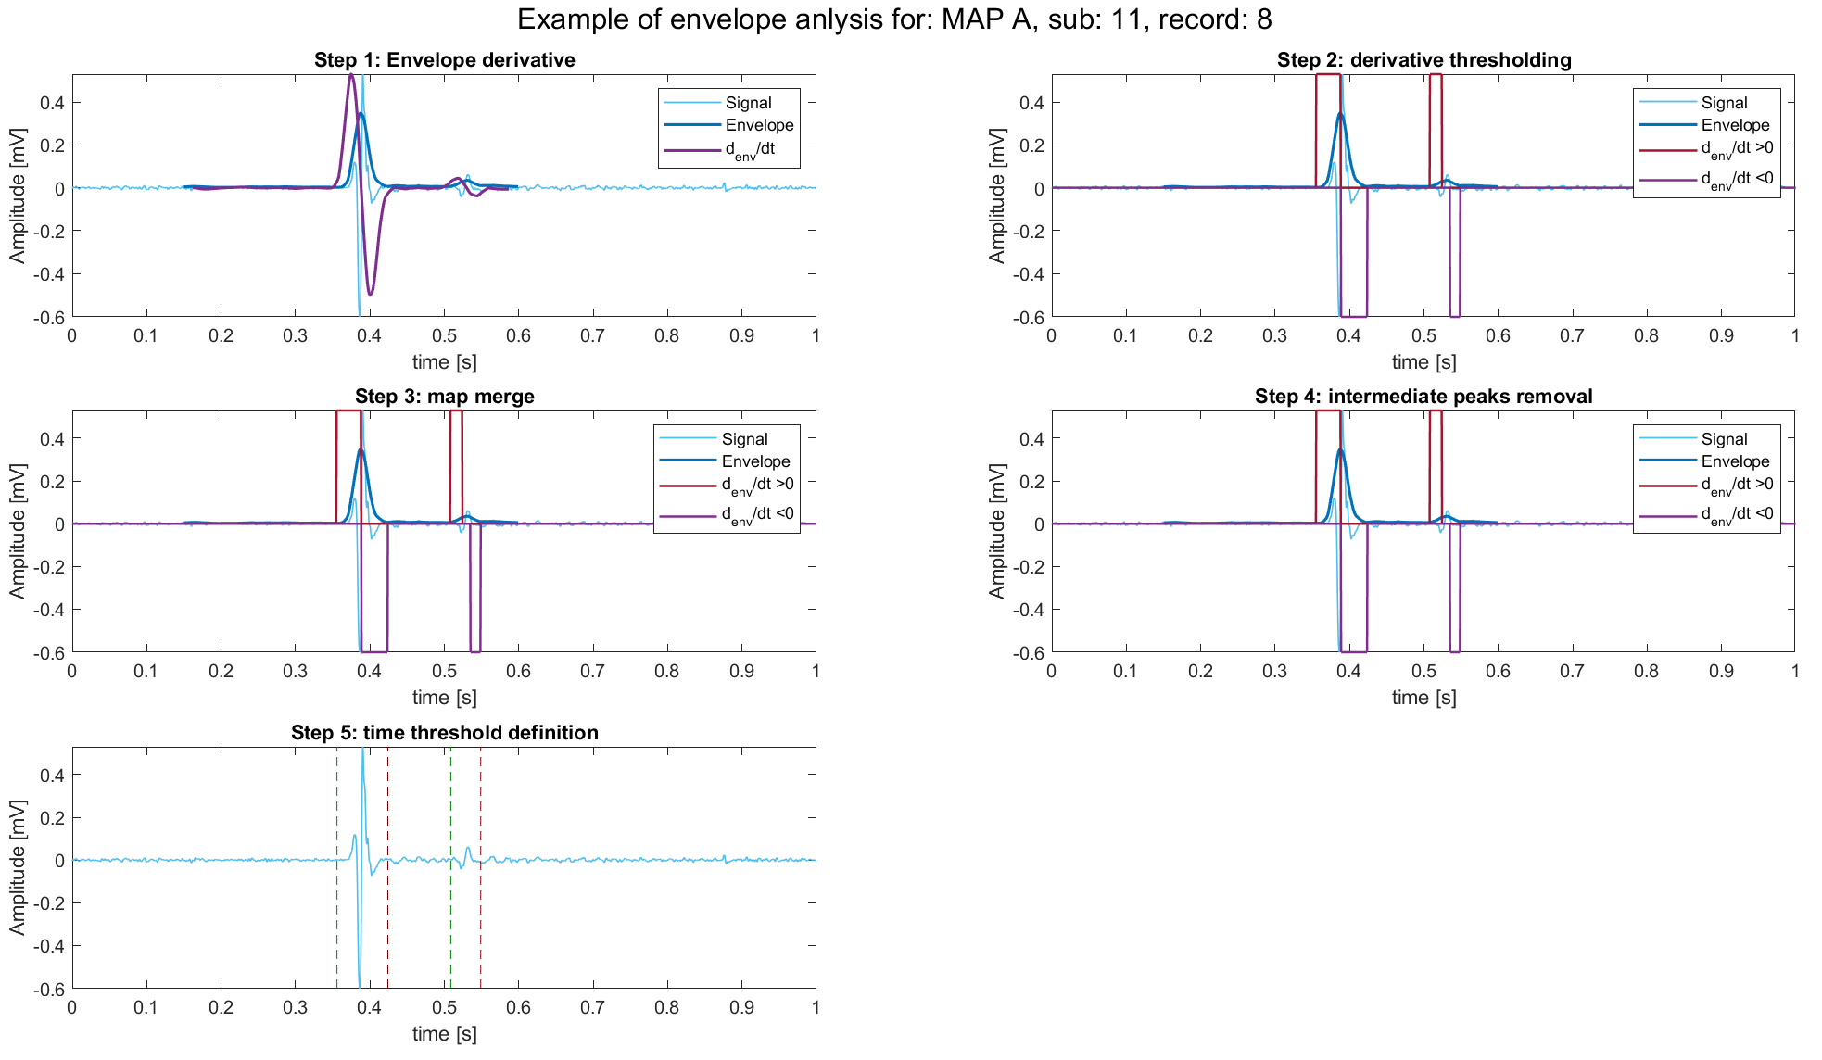
MAP A: positive result

Slide 12
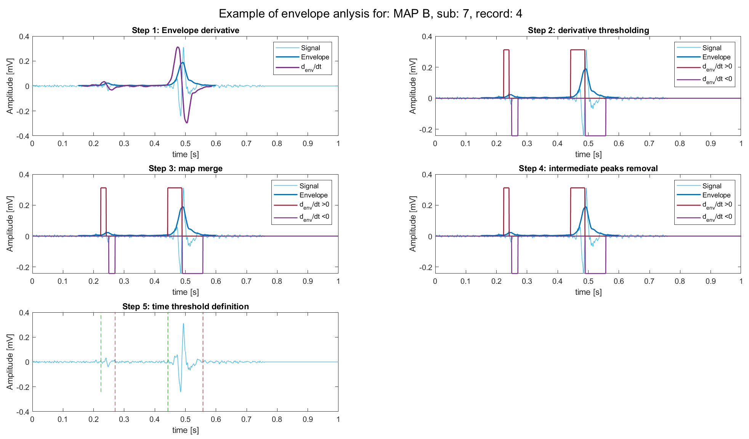
MAP B: positive result

Slide 13
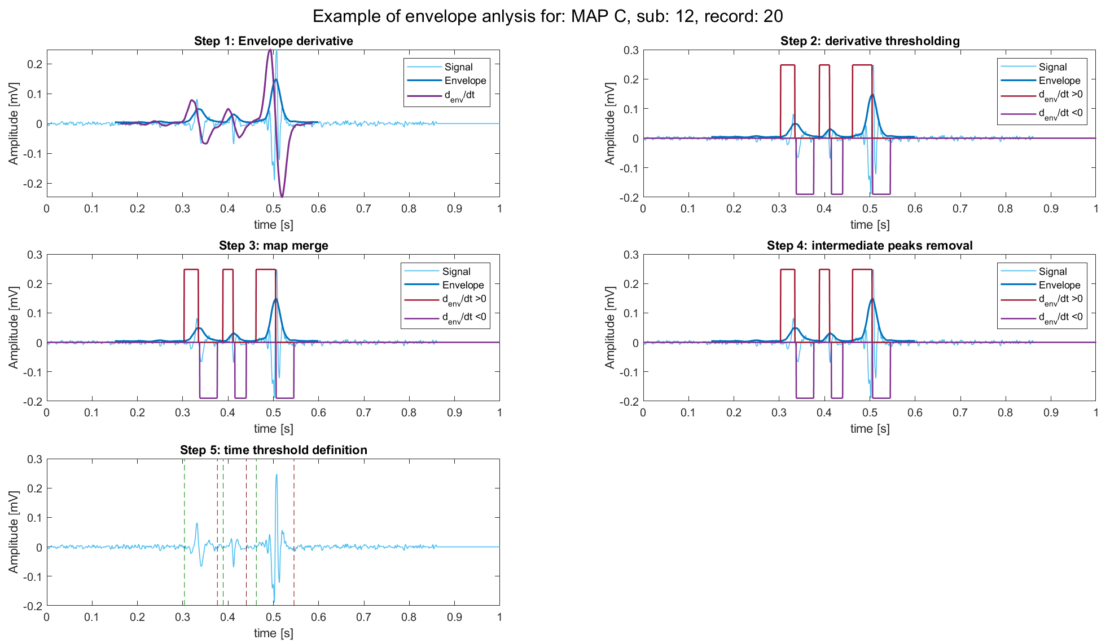
MAP C: positive result

Slide 14
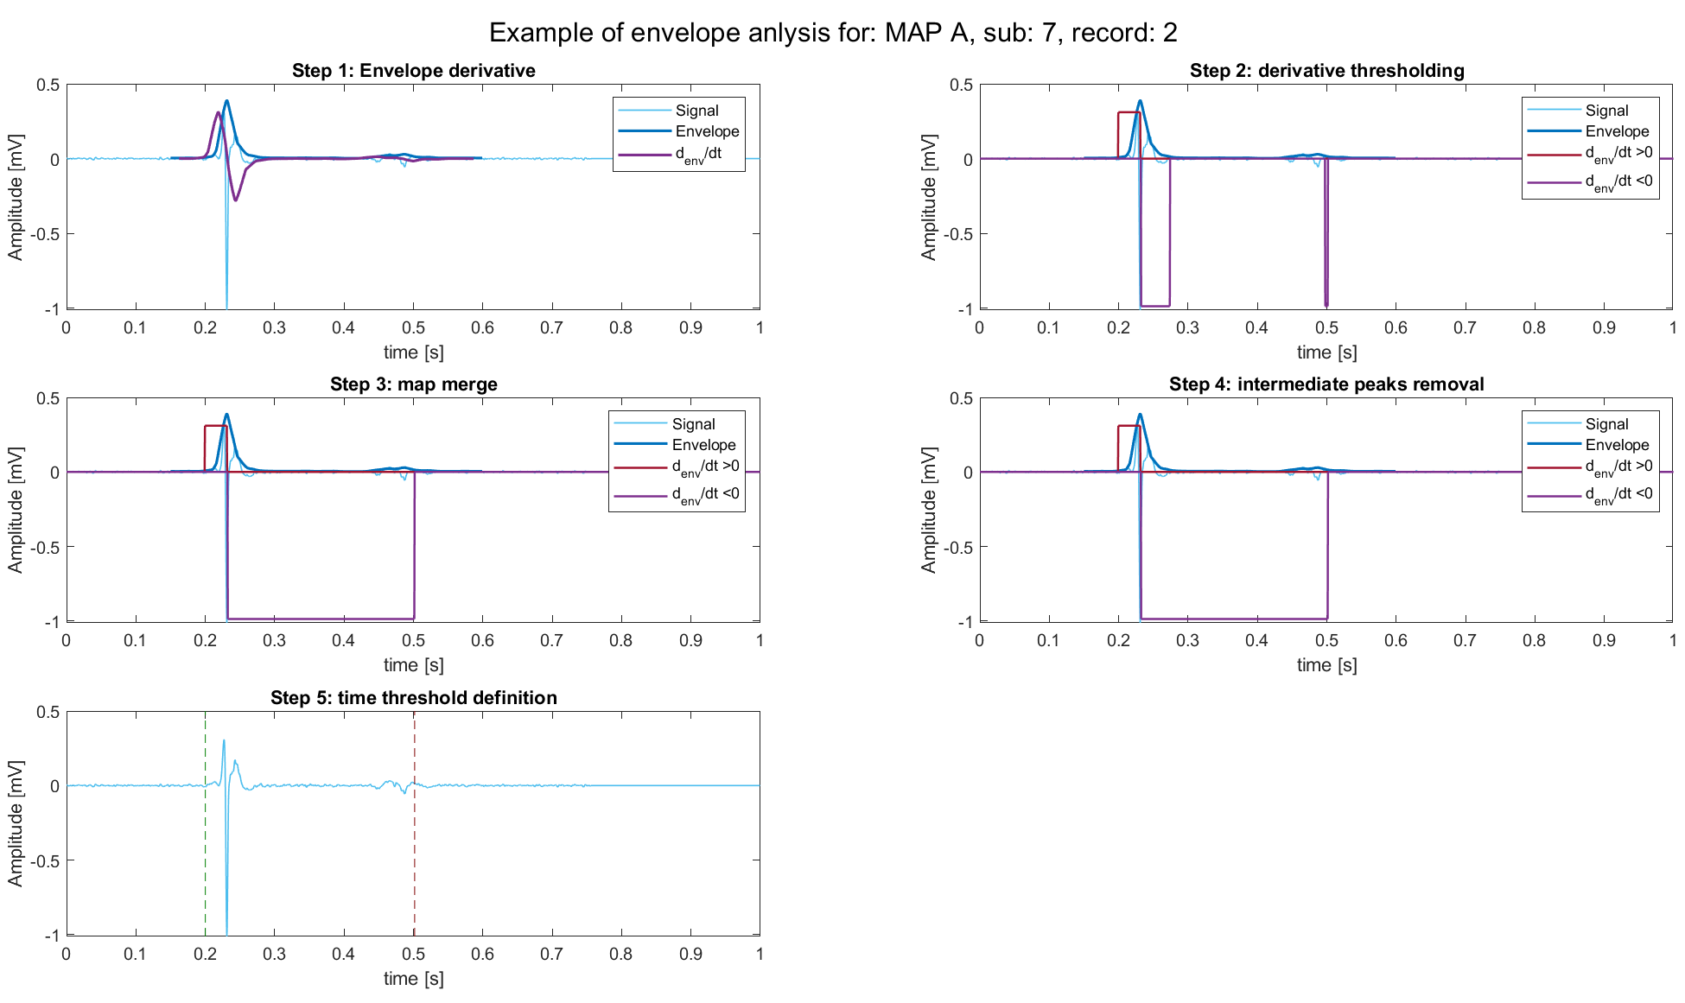
MAP A: misleading result

Slide 15
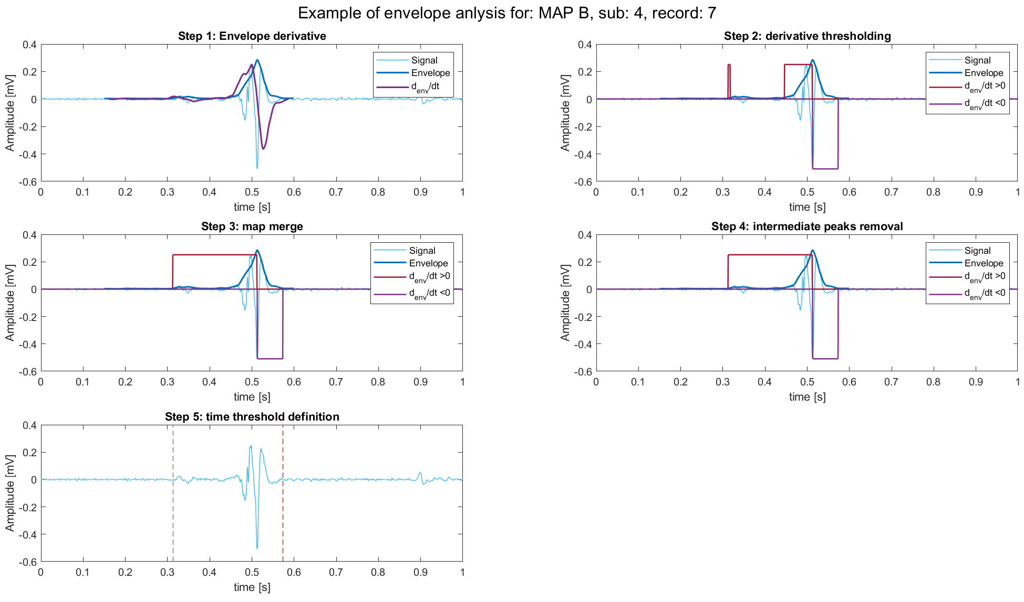
MAP B: negative result

Slide 16
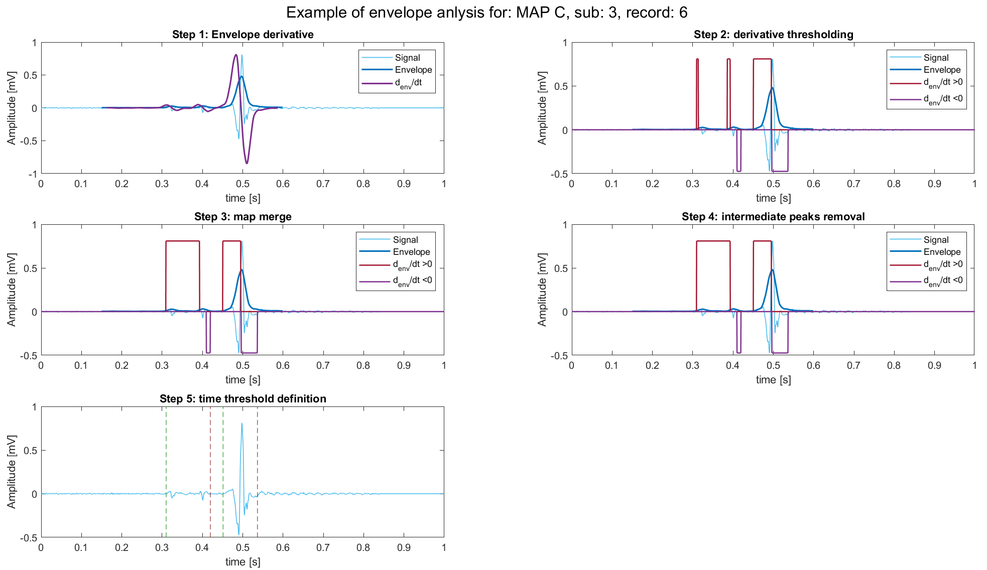
MAP C: misleading result

Slide 17
Outline
Aim of envelope analysis
Envelope analysis pipeline
Envelope derivative
Derivative thresholding and merging
False peak detection
Time thresholds definition
Results
Positive results
Misleading results
Proposed features
Conclusions

Slide 18
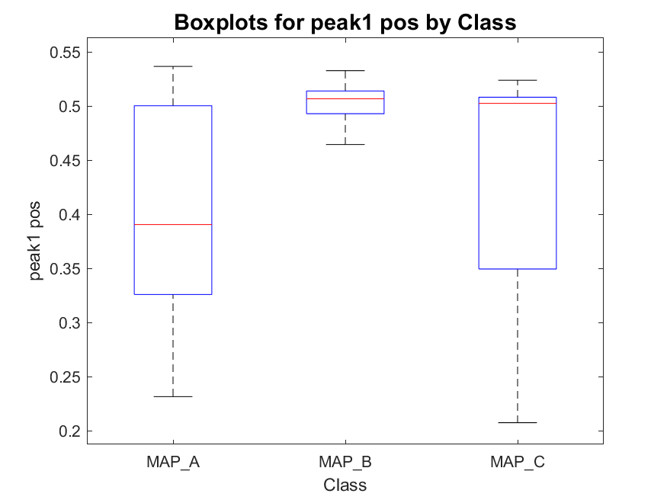
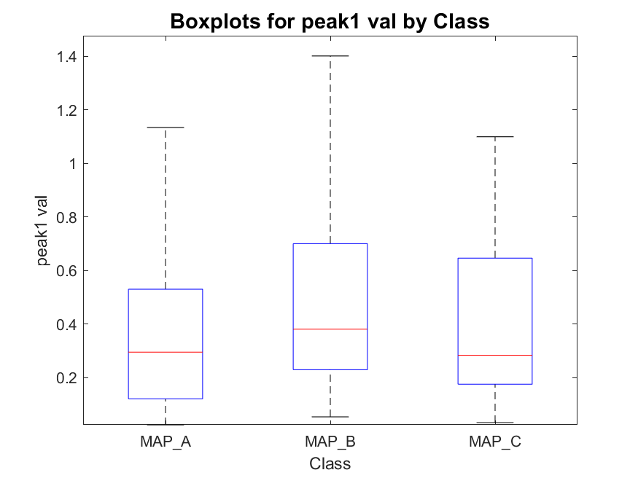
Envelope peak 1 (highest) position and value
MAP_A has:
- 198 signals with one peak
- 490 signals with two peaks
- 56 signals with three peaks
total : 744
MAP_B has:
- 22 signals with one peak
- 81 signals with two peaks
- 8 signals with three peaks
total : 111
MAP_C has:
- 25 signals with one peak
- 42 signals with two peaks
- 45 signals with three peaks
total : 112

Slide 19
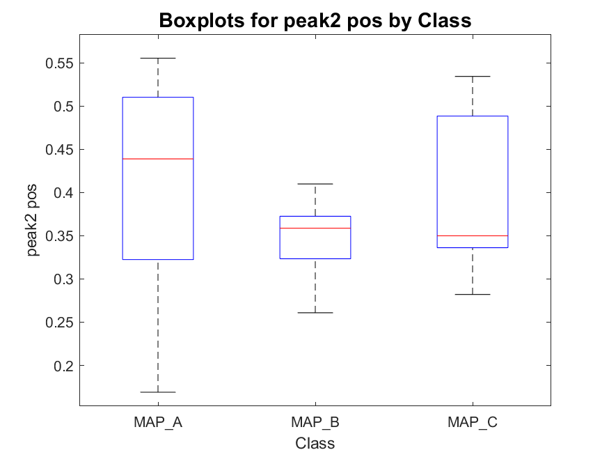
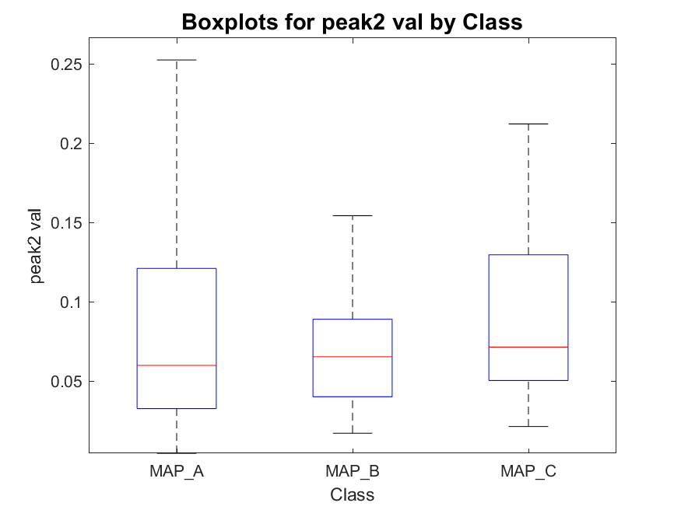
Envelope peak 2 (second highest) position and value
MAP_A has:
- 198 signals with one peak
- 490 signals with two peaks
- 56 signals with three peaks
total : 744
MAP_B has:
- 22 signals with one peak
- 81 signals with two peaks
- 8 signals with three peaks
total : 111
MAP_C has:
- 25 signals with one peak
- 42 signals with two peaks
- 45 signals with three peaks
total : 112

Slide 20
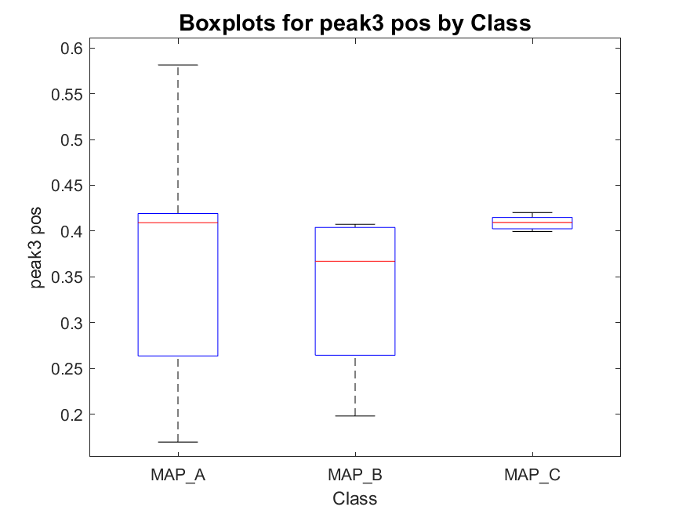
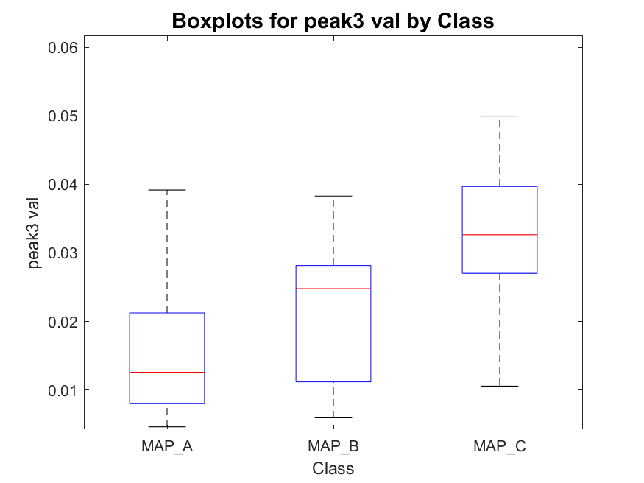
Envelope peak 3 (third highest) position and value
MAP_A has:
- 198 signals with one peak
- 490 signals with two peaks
- 56 signals with three peaks
total : 744
MAP_B has:
- 22 signals with one peak
- 81 signals with two peaks
- 8 signals with three peaks
total : 111
MAP_C has:
- 25 signals with one peak
- 42 signals with two peaks
- 45 signals with three peaks
total : 112

Slide 21
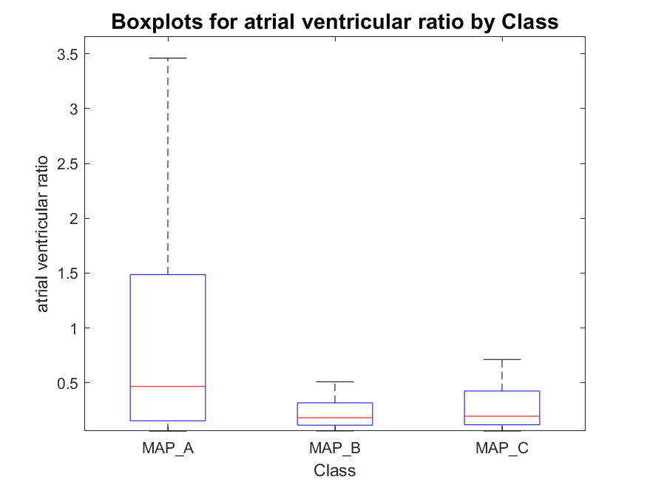
Atrial-to-ventricular envelope peaks ratio
MAP_A has:
- 198 signals with one peak
- 490 signals with two peaks
- 56 signals with three peaks
total : 744
MAP_B has:
- 22 signals with one peak
- 81 signals with two peaks
- 8 signals with three peaks
total : 111
MAP_C has:
- 25 signals with one peak
- 42 signals with two peaks
- 45 signals with three peaks
total : 112

Slide 22
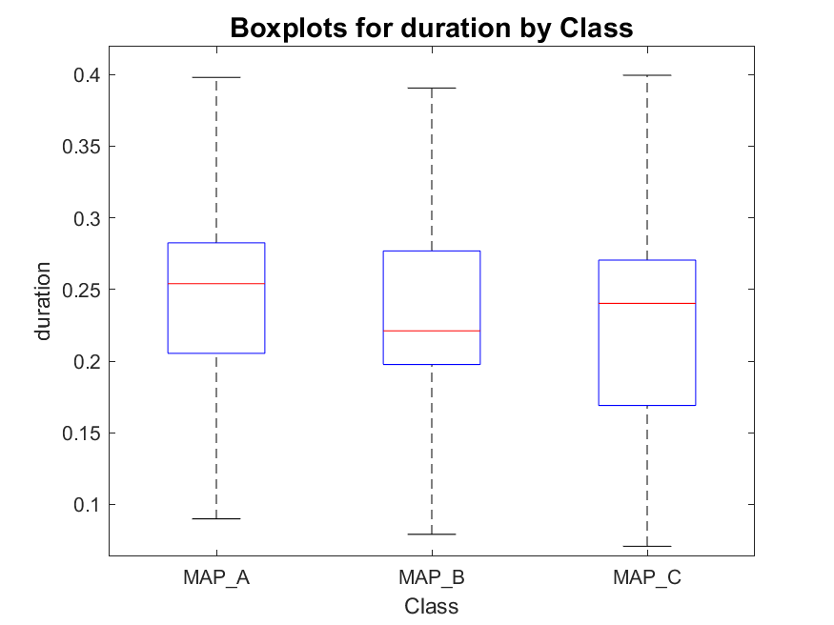
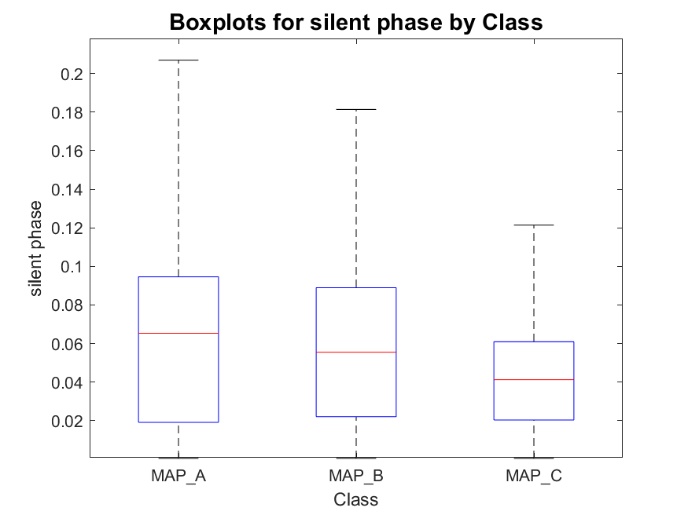
Active phase duration and silent phase duration
MAP_A has:
- 198 signals with one peak
- 490 signals with two peaks
- 56 signals with three peaks
total : 744
MAP_B has:
- 22 signals with one peak
- 81 signals with two peaks
- 8 signals with three peaks
total : 111
MAP_C has:
- 25 signals with one peak
- 42 signals with two peaks
- 45 signals with three peaks
total : 112

Slide 23
Outline
Aim of envelope analysis
Envelope analysis pipeline
Envelope derivative
Derivative thresholding and merging
False peak detection
Time thresholds definition
Results
Positive results
Misleading results
Proposed features
Conclusions

Slide 24
Conclusions
The proposed pipeline is a first step towards an automated detection of active phases of the signal.
Pros
Automated time-windows definition
High sensibility even to small peaks
Cons
High sensibility to the thresholds used
Merge/removing rules could introduce errors
Peaks cleaning step can be misleading
Sometimes threshold seem to be too low, leading to “false negative” peaks
But in other cases, seems to be too high, leading to “false positive” peaks
In both cases the problem is related to signal amplitude together with threshold definition. More evaluations should be done.
Feature proposed give some initial indications for the classification:
Third highest peak position and value seems to be discriminative of MAP C
Atrial/ventricular peak ratio is confirmed to be a discriminative feature for MAP A

